Slide 1


Dr.SNS RAJALAKSHMI COLLEGE OF ARTS AND SCIENCE
(AUTONOMOUS)
COIMBATORE-641049
Accredited by NAAC(Cycle III) with “A+” Grade
Recognised by UGC, Approved by AICTE, New Delhi and
Affiliated to Bharathiar University, Coimbatore.
DEPARTMENT OF COMPUTER SCIENCE
21PCS101:Artificial Intelligence for Robotics
I YEAR - I SEM
UNIT 1 – Foundation for Advanced Robotics and AI
TOPIC – The basic principle of robotics and AI

Slide 2
Outline
What is Artificial Intelligence (AI)?
Modern AI – nothing new
Our example problem
What you will learn in this book – AI techniques covered
Introduction to TinMan, our robot
Keeping control – soft real-time control
The OODA loop – basis for decision making

Slide 3
Technical Requirements
Python 2.7 or 3.5 with numpy, scipy, matplotlib, and scikit-learn installed.
Robotics Operating System (ROS) Kinetic Kame.
A computer running Linux for development or a virtual machine running Linux under Windows. Ubuntu 16.04 is used for the examples and illustrations.
Raspberry Pi 3 or a similar single board computer (BeagleBone Black, Odroid, or similar). We are not using the GPIO or special interfaces on the Pi3.
An Arduino Mega 2560 microcontroller.

Slide 4
Technical Requirements
The repository for the source code in this chapter on GitHub is: https://github.com/ FGovers/AI_and_Robotics_source_code/chapter_1
Check out the following video to see the Code in Action: http://bit.ly/2BT0Met

Slide 5
Website References
https://towardsdatascience.com/top-5-machine-learning-libraries-in-python-e36e3e0e02af
https://www.theconstructsim.com/history-ros/
https://www.theconstructsim.com/timeline-robot-operating-system-ros/
https://en.wikipedia.org/wiki/Robot_Operating_System

Slide 6
The basic principle of robotics and AI
You probably have a quadcopter or a 3D printer (which is, in fact, a robot).
The familiar world of Proportional Integral Derivative (PID) controllers, sensor loops, and state machines must give way to artificial neural networks, expert systems, genetic algorithms, and searching path planners.
We want a robot that does not just react to its environment as a reflex action, but has goals and intent—and can learn and adapt to the environment. We want to solve problems that would be intractable or impossible otherwise.

Slide 7
The basic principle of robotics and AI
What we are going to do in this manuscript is introduce a problem – picking up toys in a playroom—that we will use as our example throughout the manuscript as we learn a series of techniques for applying AI techniques to our robot.
At the end of the manuscript, you should gain some important skills with broad applicability, not just learn how to pick up toys

Slide 8
The basic principle of robotics and AI
This is a manuscript about how to apply AI tools to robotics problems
This is primarily an AI book using robotics as an example.
The tools and techniques learned will have applicability even if you don’t do robotics, but just apply AI to decision making to trade on the stock market.

Slide 9
The basic principle of robotics and AI
We will use the Python programming language, the ROS for our data infrastructure, and be running under the Linux operating system.
I developed the examples in the manuscript with Oracle’s VirtualBox software running Ubuntu Linux in a virtual machine on a Windows Vista computer.
Our robot hardware will be a Raspberry Pi 3 as the robot’s on-board brain, and an Arduino Mega2560 as the hardware interface microcontroller.

Slide 10
The basic principle of robotics and AI
In the rest of this chapter, we will discuss some basics about AI, and then proceed to develop two important tools that we will use in all of the examples in the rest of the manuscript.
We will introduce the concept of soft real-time control, and then provide a framework, or model, for interfacing AI to our robot called the Observe-Orient-Decide-Act (OODA) loop.

Slide 11
What is AI (and what is it not)?
What would be a definition of AI?
In general, it means a machine that exhibits some characteristics of intelligence—thinking, reasoning, planning, learning, and adapting.
It can also mean a software program that can simulate thinking or reasoning.

Slide 12
What is AI (and what is it not)?
Examples:
A robot that avoids obstacles by simple rules (if the obstacle is to the right, go left) is not an AI.
A program that learns by example to recognize a cat in a video, is an AI.
A mechanical arm that is operated by a joystick is not AI, but a robot arm that adapts to different objects in order to pick them up is AI.

Slide 13
What is AI (and what is it not)?
Two defining characteristics of artificial intelligence robots
First of all, AI robots learn and adapt to their environments, which means that they change behaviors over time.
The second characteristic is emergent behavior, where the robot exhibits developing actions that we did not program into it explicitly.

Slide 14
What is AI (and what is it not)?
One concept you will hear around AI circles is the Turing test.
The Turing test was proposed by Alan Turing in 1950, in a paper entitled Computing Machinery and Intelligence.
I don’t believe that AI has progressed to this point yet, but chat bots and automated answering services have done a good job of making you believe that you are talking to a human and not a robot

Slide 15
What is AI (and what is it not)?
Our objective in this manuscript is not to pass the Turing test, but rather to take some novel approaches to solving problems using techniques in machine learning, planning, goal seeking, pattern recognition, grouping, and clustering. Many of these problems would be very difficult to solve any other way.
A software AI that could pass the Turing test would be an example of a general artificial intelligence, or a full, working intelligent artificial brain, and just like you, a general AI does not need to be specifically trained to solve any particular problem.

Slide 16
What is AI (and what is it not)?
To date, a general AI has not been created, but what we do have is narrow AI, or software that simulates thinking in a very narrow application, such as recognizing objects, or picking good stocks to buy.

Slide 17
What is AI (and what is it not)?
What is a robot?
A robot is a machine that is capable of sensing and reacting to its environment, and that has some human or animal-like function.
Generally think of a robot as some sort of automated, self-directing mobile machine that can interact with the environment

Slide 18
What is AI (and what is it not)?
The example problem – clean up this room!
Where does the robot work?
Divide environments into two categories: structured and unstructured.

Slide 19
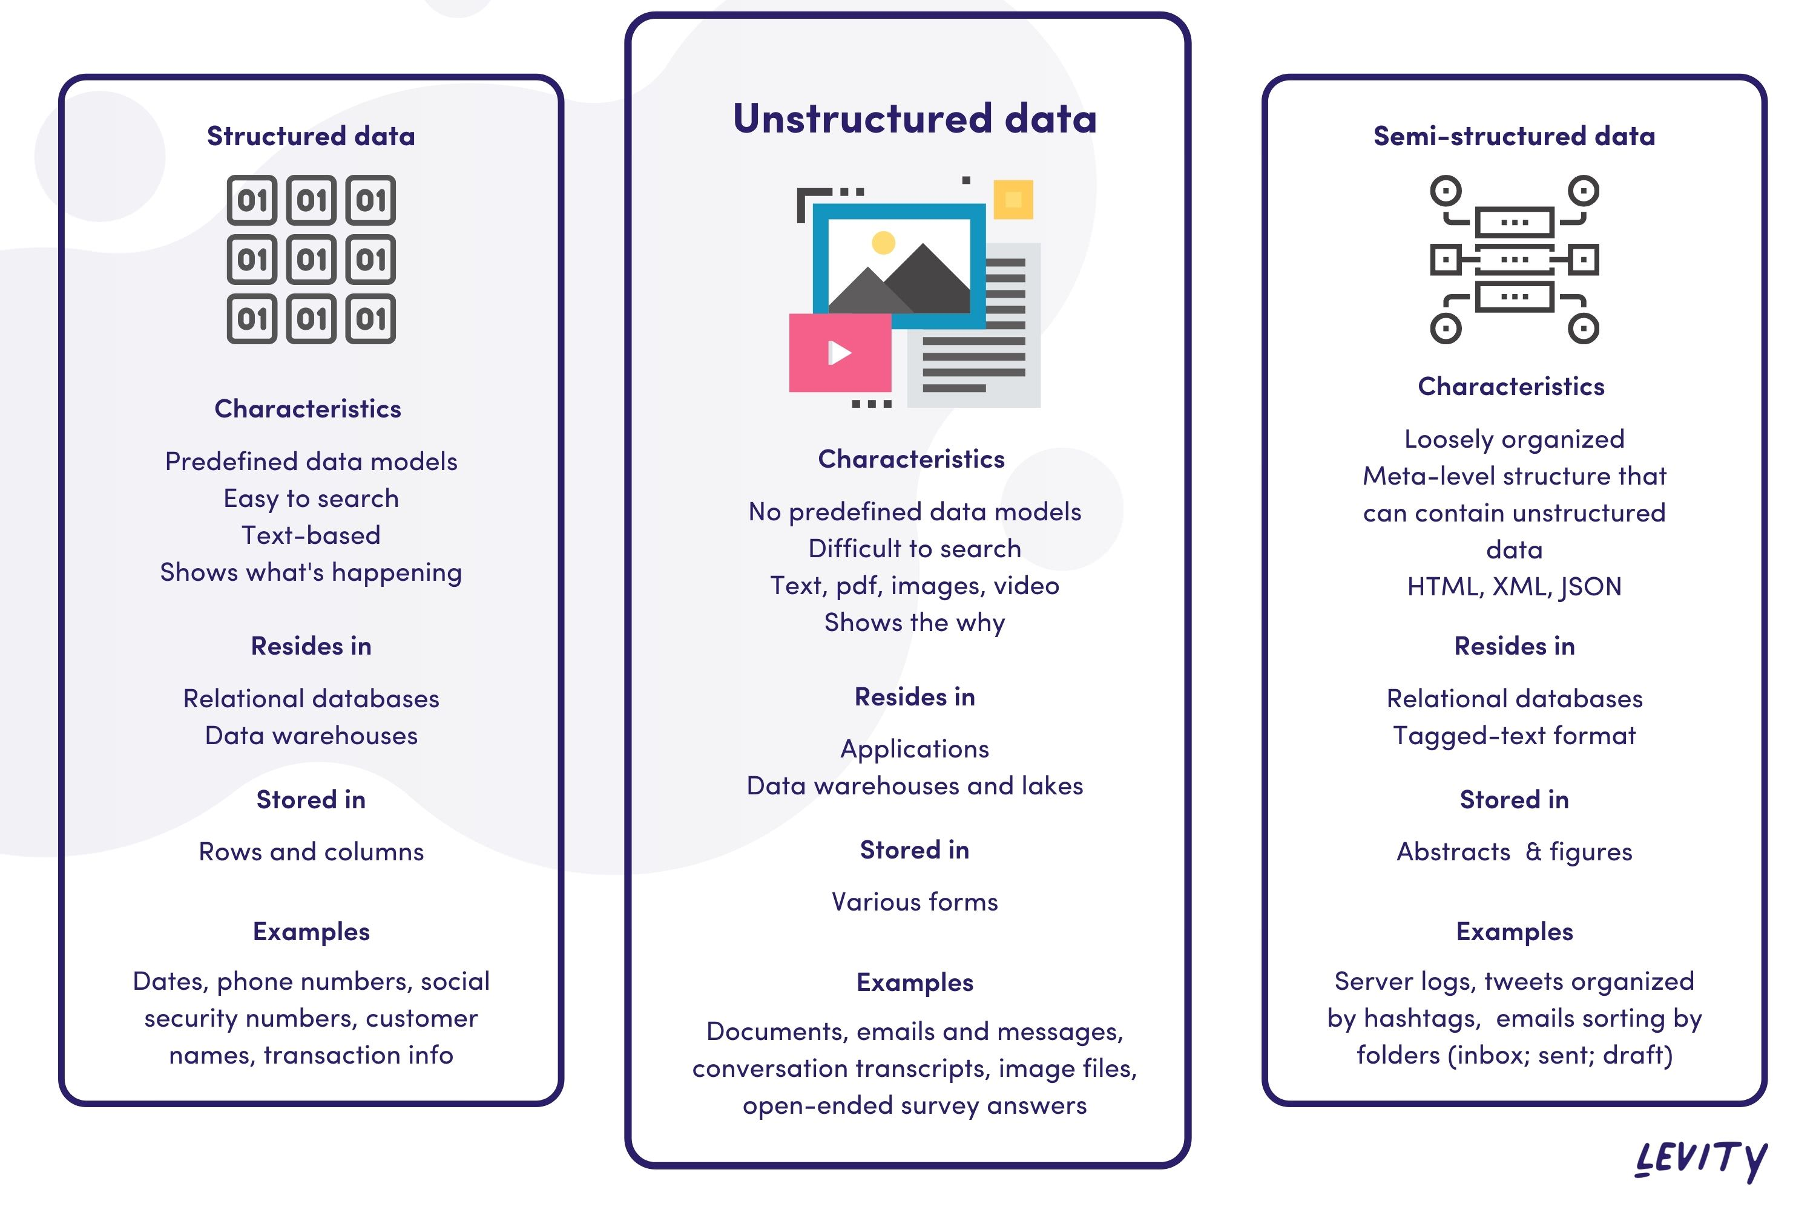
What is AI (and what is it not)?

Slide 20
What is AI (and what is it not)?
The problem is to have the robot drive around the room, and pick up toys.
Let's break this task down into a series of steps:
We want the user to interact with the robot by talking to it. We want the robot to understand what we want it to do, which is to say, what our intent is for the commands we are giving it.

Slide 21
What is AI (and what is it not)?
2. Once commanded to start, the robot will have to identify an object as being a toy, and not a wall, a piece of furniture, or a door
3. The robot must avoid hazards, the most important being the stairs going down to the first floor. Robots have a particular problem with negative obstacles (drop-offs, curbs, cliffs, stairs, and so on), and that is exactly what we have here.

Slide 22
What is AI (and what is it not)?
4. Once the robot finds a toy, it has to determine how to pick the toy up with its robot arm. Can it grasp the object directly, or must it scoop the item up, or push it along? We expect that the robot will try different ways to pick up toys and may need several trial and error attempts.
5. Once the toy is acquired by the robot arm, the robot needs to carry the toy to a toy box. The robot must recognize the toy box in the room, remember where it is for repeat trips, and then position itself to place the toy in the box. Again, more than one attempt may be required.

Slide 23
What is AI (and what is it not)?
6. After the toy is dropped off, the robot returns to patrolling the room looking for more toys. At some point, hopefully, all of the toys are retrieved. It may have to ask us, the human, if the room is acceptable, or if it needs to continue cleaning.
What will we be learning from this problem? We will be using this backdrop to examine a variety of AI techniques and tools.
The purpose of the manuscript is to teach you how to develop AI solutions with robots.

Slide 24
What is AI (and what is it not)?
It is the process and the approach that is the critical information here, not the problem and not the robot I developed so that we have something to take pictures of for the book.
We will be demonstrating techniques for making a moving machine that can learn and adapt to its environment.
The first three chapters are foundation material that support all of the rest of the book by setting up the problem and providing a firm framework to attach all of the rest of the material.

Slide 25
What is AI (and what is it not)?
What you will learn
Building a firm foundation for robot control by understanding control theory and timing.
We will be using a soft real-time control scheme with what I call a frame-based control loop. This technique has a fancy technical name – rate monotonic scheduling—but I think you will find the concept fairly intuitive and easy to understand.
At the most basic level, AI is a way for the robot to make decisions about its actions.

Slide 26
What is AI (and what is it not)?
We will introduce a model for decision making that comes from the US Air Force, called the OODA (Observe- Orient-Decide- Act) loop.
Our robot will have two of these loops:
An inner loop or introspective loop, and an outward looking environment sensor loop.
The lower, inner loop takes priority over the slower, outer loop, just as the autonomic parts of your body (heartbeat, breathing, eating) take precedence over your task functions (going to work, paying bills, mowing the lawn).

Slide 27
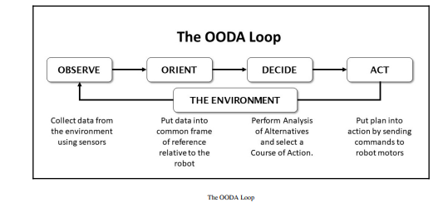
What is AI (and what is it not)?

Slide 28
What is AI (and what is it not)?
The OODA loop was invented by Col. John Boyd, a man also called The Father of the F-16. Col.
The OODA loop is used to describe robot artificial intelligence, military planning, or marketing strategies with equal utility.
The OODA provides a model for how a thinking machine that interacts with its environment might work.

Slide 29
Artificial intelligence and advanced robotics techniques
Detail a step-by-step example of the application of a different AI approach.
We start with object recognition - use a trained artificial neural network (ANN) to recognize objects from a video camera from various angles and lighting conditions.
The next task, once a toy is identified, is to pick it up. Writing a general purpose pick up anything program for a robot arm is a difficult task involving a lot of higher mathematics (google inverse kinematics to see what I mean).

Slide 30
Artificial intelligence and advanced robotics techniques
What if we let the robot sort this out for itself? We use genetic algorithms that permit the robot to invent its own behaviors and learn to use its arm on its own.
Our robot needs to understand commands and instructions from its owner (us). We use natural language processing to not just recognize speech, but understand intent for the robot to create goals consistent to what we want it to do.

Slide 31
Artificial intelligence and advanced robotics techniques
The robot’s next problem is avoiding the stairs and other hazards. We will use operant conditioning to have the robot learn through positive and negative reinforcement where it is safe to move.

Slide 32
Artificial intelligence and advanced robotics techniques
The robot will need to be able to find the toy box to put items away, as well as have a general framework for planning moves into the future. We will use decision trees for path planning, as well as discuss pruning for quickly rejecting bad plans. We will also introduce forward and backwards chaining as a means to quickly plan to reach a goal.
The state of the art in robotics or AI today, we can simulate having a personality with a finite state machine and some Monte-Carlo modeling.

Slide 33
Introducing the robot and our development environment
As shown in the photo, our robot has tracks, a mechanical six degree-of-freedom arm, and a computer.
Let's call him TinMan, since, like the storybook character in The Wizard of Oz, he has a metal body and all he wants for is a brain.

Slide 34
Artificial intelligence and advanced robotics techniques
Our tasks in this book center around picking up toys in an interior space, so our robot has a solid base with two motors and tracks for driving over a carpet. Our steering method is the tank-type, or differential drive where we steer by sending different commands to the track motors.
If we want to go straight ahead, we set both motors to the same forward speed. If
we want to travel backward, we reverse both motors the same amount.

Slide 35
Artificial intelligence and advanced robotics techniques
Turns are accomplished by moving one motor forward and the other backward (which makes the robot turn in place) or by giving one motor more forward drive than the other.
We can make any sort of turn this way. In order to pick up toys we need some sort of manipulator, so I've included a six-axis robot arm that imitates a shoulder – elbow – wrist- hand combination that is quite dexterous, and since it is made out of standard digital servos, quite easy to wire and program.

Slide 36
Artificial intelligence and advanced robotics techniques
You will note that the entire robot runs on one battery. You may want to split that and have a separate battery for the computer and the motors.
This is a common practice, and many of my robots have had separate power for each. Make sure if you do to connect the ground wires of the two systems together. I've tested my power supply carefully and have not had problems with temperature or noise, although I don't run the arm and drive motors at the same time.
If you have noise from the motors upsetting the Arduino (and you will tell because the Arduino will keep resetting itself), you can add a small filter capacitor of 10 μf across the motor wires.

Slide 37
Artificial intelligence and advanced robotics techniques

Slide 38
Artificial intelligence and advanced robotics techniques
The main control of the TinMan robot is the Raspberry Pi 3 single board computer (SBC),that talks to the operator via a built-in Wi-Fi network.
An Arduino Mega 2560 controller based on the Atmel architecture provides the interface to the robot's hardware components, such as motors and sensors.
The primarily concerned with the Raspberry Pi3 single board computer (SBC), which is the brains of our robot.
The Raspberry Pi 3 acts as the main interface between our control station, which is a PC running Linux in a virtual machine, and the robot itself via a Wi-Fi network.

Slide 39
Artificial intelligence and advanced robotics techniques
our motors draw more current than the Arduino can handle itself, we need a motor controller to amplify our commands into enough power to move the robot’s tracks.
The servos are plugged directly into the Arduino, but have their own connection to the robot’s power supply.
We also need a 5v regulator to provide the proper power from the 11.1v rechargeable lithium battery power pack into the robot. My power pack is a rechargeable 3S1P (three cells in series and one in parallel) 2,700 ah battery normally used for quadcopter drones, and came with the appropriate charger. As with any lithium battery, follow all of the directions that came with the battery pack and recharge it in a metal box or container in case of fire.

Slide 40
Software components (ROS, Python, and Linux)
Python is a great language for this purpose for two great reasons:
it is widely used in the robotics community in conjunction with ROS,
it is also widely accepted in the machine learning and AI community.
Python is an interpreted language, which has three amazing advantages for us:
Portability: Python is very portable between Windows, Mac, and Linux.
As an interpreted language, Python does not require a compile step.

Slide 41
Software components (ROS, Python, and Linux)
Isolation. It is a benefit that does not get talked about much, but having had a lot of experience with crashing operating systems with robots, I can tell you that the fact that Python’s interpreter is isolated from the core operating system means that having one of your Python ROS programs crash the computer is very rare. A computer crash means rebooting the computer and also probably losing all of your data you need to diagnose the crash. I had a professional robot project that we moved from Python to C++, and immediately the operating system crashes began, which shot the reliability of our robot. If a Python program crashes, another program can monitor that and restart it. If the operating system is gone, there is not much you can do without some extra hardware that can push the reset button for you.

Slide 42
Robot control systems and a decision-making framework
Two sets of tools in the sections:
soft real-time control and the
OODA loop.
One gives us a base for controlling the robot easily and consistently, and the other provides a basis for all of the robot’s autonomy.

Slide 43
Robot control systems and a decision-making framework
Soft real-time control
The basic concept of how a robot works, especially one that drives, is fairly simple. There is a master control loop that does the same thing over and over; it reads data from the sensors and motor controller, looks for commands from the operator (or the robot's autonomy functions), makes any changes to the state of the robot based on those commands, and then sends instructions to the motors or effectors to make the robot move:

Slide 44
Robot control systems and a decision-making framework

Slide 45
Robot control systems and a decision-making framework
The preceding diagram illustrates how we have instantiated the OODA loop into the software and hardware of our robot.
The robot can either act autonomously, or accept commands from a control station connected via a wireless network.

Slide 46
Robot control systems and a decision-making framework
What we need to do is perform this control loop in a consistent manner all of the time. We
need to set a base frame rate, or basic update frequency, in our control loop. This makes all
of the systems of the robot perform better. Without some sort of time manager, each
control cycle of the robot takes a different amount of time to complete, and any sort of path planning, position estimate, or arm movement becomes more complicated.

Slide 47
Robot control systems and a decision-making framework
If you have used a PID controller before to perform a process, such as driving the robot at a consistent speed, or aiming a camera at a moving target, then you will understand that
having even-time steps is important to getting good results.

